Slide 1




Search Engine Optimization (SEO)
Free SEO Course at Telerik Academy – Introduction
Svetlin Nakov
Senior Technical Trainer
Telerik Corporation
www.telerik.com

Slide 2

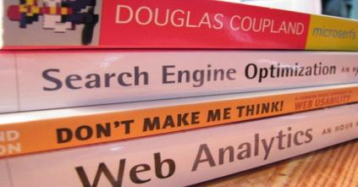
Table of Contents
About Telerik and Telerik Academy
What is SEO?
About the SEO Course
Trainers Team
Course Curriculum
Course Schedule and Venue
The Practical SEO Project
Assessment and Certification
Recommended Books

Slide 3


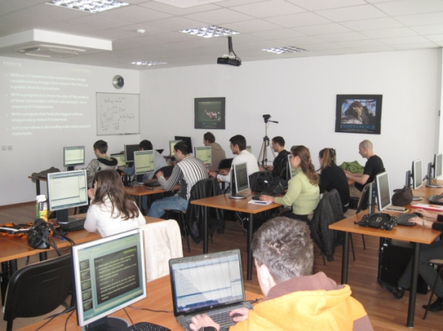

About Telerik and Telerik Academy

Slide 4
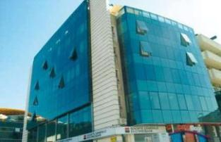
About Telerik
What Telerik does?
Leading vendor of ASP.NET AJAX and MVC, HTML5, Silverlight, WPF, Window Phone 7 components, ORM, reporting, automated testing, agile PM tools, CMS systems, VS plugins
Headquartered in Bulgaria
Offices in USA, Canada, UK, Germany, Australia
450 employees – mostly developers
Employer #1 in Bulgaria for 2010
Microsoft Gold Certified Partner

Slide 5
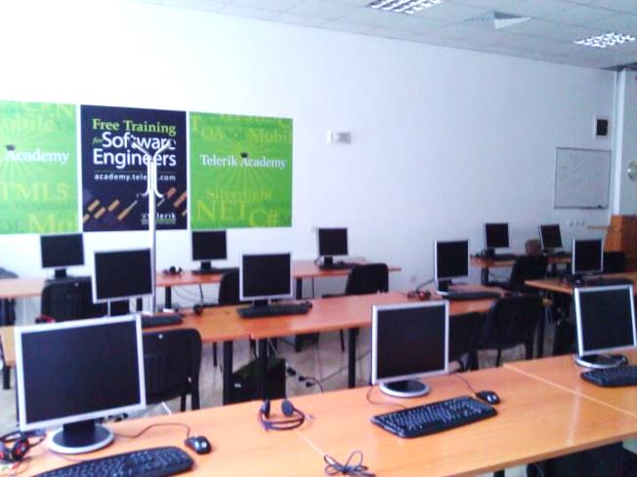
About Telerik Academy
Telerik Academy is an initiative Telerik for training of young software engineers
Four main streams
Software Academy
.NET Essentials
QA Academy
Developer Support
School Academy
Kids Academy
Student Courses

Slide 6
Free Courses for Students
Courses for Students
Cross-Platform Mobile Applications (starting October, FMI)
Native Mobile Development (iOS, Android, Windows Phone 7)
(starting March)
Web Applications with ASP.NET MVC
(starting October, FMI)
High-Quality Programming Code (starting March)
Web Client-Side Development (starting October)
XAML Development
(starting March)
Search Engine Optimization (starting November)
Web Front-End Development
(starting March)

Slide 7





What is SEO?
Search Engine Optimization

Slide 8
What is SEO, SEM, E-Marketing?
Search engine optimization (SEO)
The process of improving the visibility of a Web site or a Web page in the search engines
SEM – search engine marketing means marketing of a Web site (SEO + paid ads)
Internet marketing (Web marketing, e-marketing)
Marketing a product or service through Internet
Includes SEO, SEM, SMM (campaigns in the social networks), paid ads, e-mail marketing, …

Slide 9
Goals and Benefits of SEO
Goals of SEO (and e-marketing in general)
The Web site / page is shown at the top positions in Google / Bing / Yahoo
For certain keywords and search phrases
The Web site / page increases its visitors (customers) and increases its sales
Achieve better branding and reputation for a product / service
Target the audience better
Cut the marketing costs

Slide 10





About the SEO Course
What Will You Learn?
Course Requirements

Slide 11

About the SEO Course
Search Engine Optimization (SEO) course
Provides concepts, techniques, tools and skills for performing SEO
Goals of SEO for your Web site
Better search engine position, more visitors, etc.
Targets school and university students, and any other people interested in SEO technologies
Prepares for a career in the area of Web marketing, SEO, SEM, SMM and PR
Web site: http://seocourse.telerik.com

Slide 12
Requirements to the Students
Desire to learn SEO
Willingness to learn the Web technologies, SEO techniques, tools and technologies
Serious attitude to the course
Put enough effort and time for this course
Work every week on homework and projects
English language
Most training materials are in English
Some of the lectures will be in Bulgarian

Slide 13
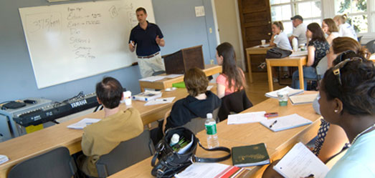
Trainers Team

Slide 14
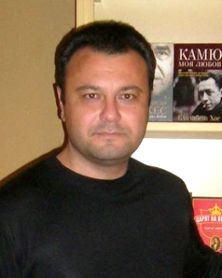
Trainers Team
Petko Dimoff
Copyrighting consultant and SEO practitioner
Author of the book "Copyrighting for the Web"
Scientific interests in psychological modeling of the Internet users' behavior
Owner of http://postvai.com, http://bezplatni.info, http://seolet.net
Web site: http://petkodimoff.hit.bg

Slide 15
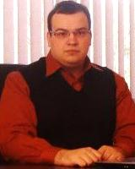
Trainers Team (2)
Kalin Vassilev
Specialist in online reputation management (ORM), SEO, SMM, SEM, e-marketing
Managing director of ORM.BG
First company for ORM services in Bulgaria
Web site: www.orm.bg
Speaker in SEO Conference 2010 and 2011

Slide 16
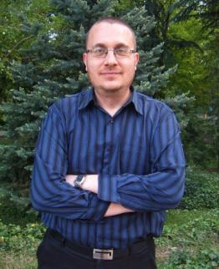
Trainers Team (3)
Borislav Arapchev
Web designer
SEO specialist
Experienced in SEO, Web design, Web portals, e-commerce solutions
Owner: www.thesmallad.com, www.webdesign-store.com
Web site: http://www.ideabg.com

Slide 17
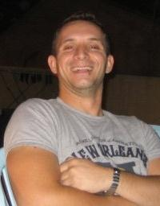
Trainers Team (4)
Georgi Mollov
SEO optimization and Internet marketing practitioner
Link building specialist
Self-employed
Blog: http://georgimollov.tumblr.com/

Slide 18
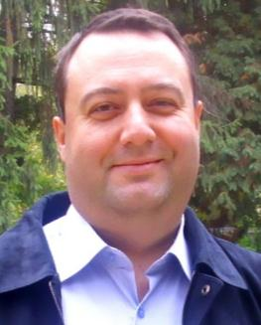
Trainers Team (5)
Mike Ramm
Entrepreneur, speaker, blogger, trainer, consultant
Project management professional and trainer
Owner of RammSoft – http://rammsoft.com
Sites and blogs:
http://mikeramm.com
http://silvermountain.wordpress.com

Slide 19
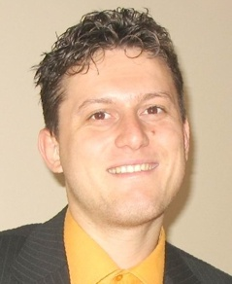
Trainers Team (6)
Svetlin Nakov, PhD
Manager Technical Training, Telerik Corp., Telerik Academy
20 years software development experience
10+ years experience as trainer
Author of 6 books
Speaker of hundreds of events
E-mail: svetlin.nakov [at] telerik.com
Web site / Blog: www.nakov.com

Slide 20

Course Curriculum

Slide 21


SEO Course Curriculum
Course Introduction
SEO Introduction
Building SEO-friendly Sites
Copywriting
Link Building
Social Media SEO
Online Reputation Management
SEO Tools
Projects Consultations
Projects Defense

Slide 22



Course Schedule & Venue

Slide 23


Course Schedule & Venue
When?
Every Monday, 18:00-22:00
Start: 21st of November 2011
Where?
Telerik Academy "Enterprise" Lab
Sofia, 1729, Mladost-1, bul. Alexander Malinov 31, Mall "The Boulevard", 2nd floor
Online:
http://seocourse.telerik.com

Slide 24
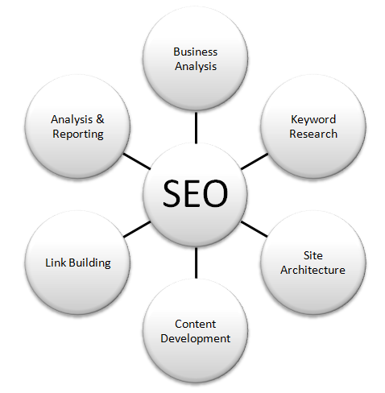

Your SEO Project
Get Practical Experience during the SEO Course

Slide 25
Your SEO Project
Each participant works on own SEO project
Requested during the course registration
Or assigned later by the trainers
At start the initial project state is measured
Daily unique visitors, Alexa rank, etc.
Homework and assignments cover the SEO work needed to be performed
Internal SEO, link building, social SEO, etc.
Each activity is filled in our form (SEO game)

Slide 26
Your SEO Project (2)
The final project state is measured at the end of the course, just before the project defense
Daily unique visitors, Alexa rank, etc.
Projects are defended after the course finishes
Each student presents his initial and final project state and a list of activities performed
Activities done need to be logged in our form
Best performing students get a certificate
Certified SEO Practitioner

Slide 27

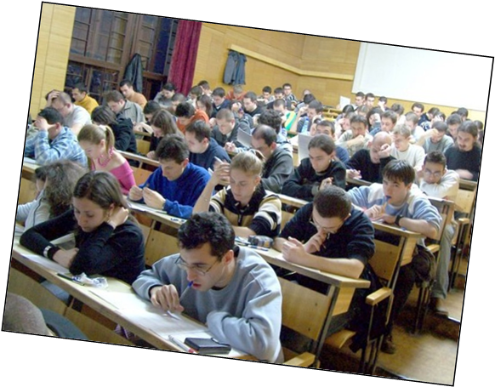
Assessment
Exams, Homework, Projects, Grades

Slide 28



Assessment
The course exams consist of everyday SEO work (homework) and a practical SEO project
Students fill their SEO activities everyday in our form called "SEO Game" (as a homework)
The practical SEO project will be defended in front of the trainers team

Slide 29

Evaluation and Grades
Evaluation criteria
Up to 75 points – practical SEO project score
Up to 25 points – homework (the SEO game)
Up to 10 points – bonus for activities in the forum
Up to 15 points – bonus for exceptional results
Score | Grade
100-125 | Certificate (6)
85-99 | Very Good (5)
70-84 | Good (4)
50-69 | Average (3)

Slide 30


Certification and Awards

Slide 31

Certification and Awards
Best students will get certification and awards
Certificate of achievement
Certified SEO Practitioner
Requires hard work and outstanding results
Signed by the trainers
Awards
Remarkable results
Top 5%-10% students
Sponsor:

Slide 32

Recommended SEO Books

Slide 33



Recommended SEO Books
"The Art of SEO: Mastering Search Engine Optimization", Eric Enge, Stephan Spencer, Rand Fishkin and Jessie Stricchiola, O'Reilly Media, 2009, ISBN 9780596518868
"SEO Fast Start", Dan Thies, 2009 (e-book)
English (original) – www.seofaststart.com
Bulgarian (translation) –www.sitershow.com/seo-book
Super Simple SEO, Brenden Clerget, www.mediafire.com/?z8dffe9dghpyaca

Slide 34



Recommended SEO Books (2)
"Making the Most of Your Content: A Publisher’s Guide to the Web", Google, 2007
http://books.google.com/googlebooks/pdf/webmastertools.pdf
"Search Engine Optimization (SEO): An Hour a Day", Jennifer Grappone, Gradiva Couzin, Sybex, 2011, ISBN 9780470902592
"Search Engine Optimization (SEO) Secrets", Danny Dover and Erik Dafforn, Wiley, 2011, ISBN 9780470554180

Slide 35
70% Discounted Hosting Offer
Our partner SuperHosting.bg is happy to offers to all students vouchers for
70% discount for the Linux and Windows hosting plans at SuperHosting.bg
40% discount for the virtual servers and the resellers program at SuperHosting.bg
More information will come later

Slide 36
Search Engine Optimization (SEO) Course – Introduction
?
?
?
?
?
Questions?
?
?
?
?
?
?
http://seocourse.telerik.com

